Slide 1


Deep Learning with Pytorch
Automated Plant Seedling Classification Using Deep Learning
Presented by:
Maher Alqarra
Professor
Mohammed Yousef Hussien
20-Dec-2024

Slide 2
Introduction
Objective: To develop an automated system to classify plant seedlings using image data.
Motivation:
Manual classification is labor-intensive and error-prone.
Early and accurate identification can optimize agricultural practices.
Goal: Achieve high accuracy in classifying plant species using deep learning.

Slide 3
Dataset Overview
Source: V2 Plant Seedlings Dataset from Kaggle
Number of Classes: 12 plant species (e.g., Black-grass, Charlock, Cleavers, etc.)
Total Images: 5,533 after cleaning and removing unwanted classes.
Class Distribution:
Varying number of images per class with some underrepresented classes.

Slide 4
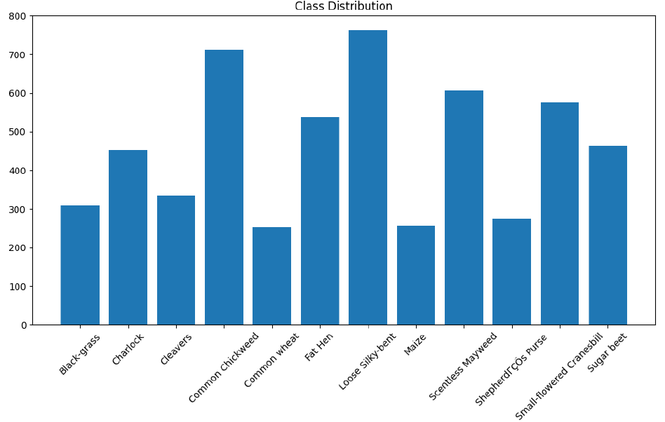
Class distribution:

Slide 5
Data Preprocessing and Augmentation
Data Preprocessing:
Images resized to 224x224 pixels.
Normalized pixel values for better model performance.
Data Augmentation:
Random cropping, horizontal flipping, and rotations to increase dataset diversity.
Train, Validation, Test Split:
70% training, 20% validation, 10% testing.

Slide 6
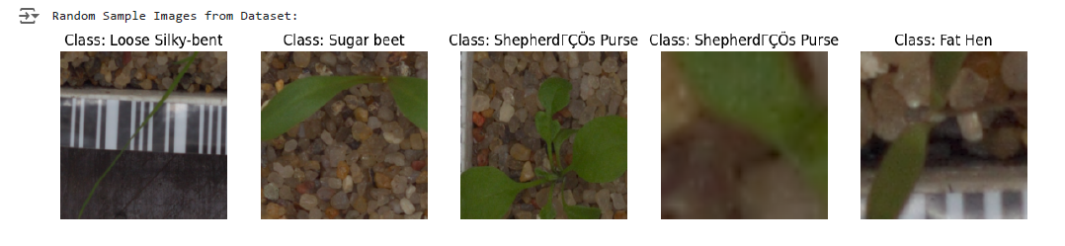
Sample image from dataset:

Slide 7
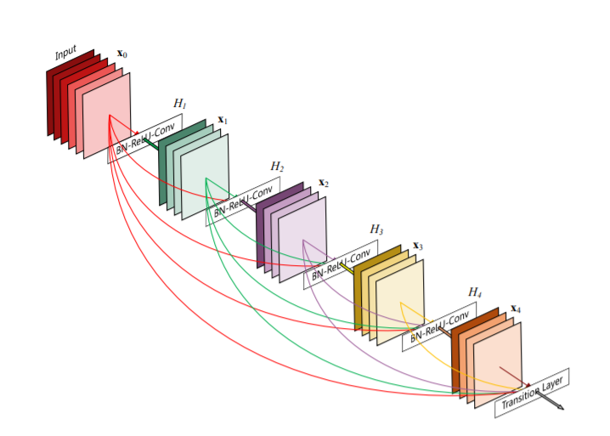
Model Architecture
Model Used: Transfer Learning with ResNet18
Why ResNet18?:
Efficient architecture with pre-trained weights.
Ability to generalize well with limited data.
Modifications:
Last layer adjusted to classify 12 plant species.
Training Parameters:
Loss Function: CrossEntropyLoss
Optimizer: Adam, Learning Rate: 0.0001
Epochs: 10, Batch Size: 32

Slide 8
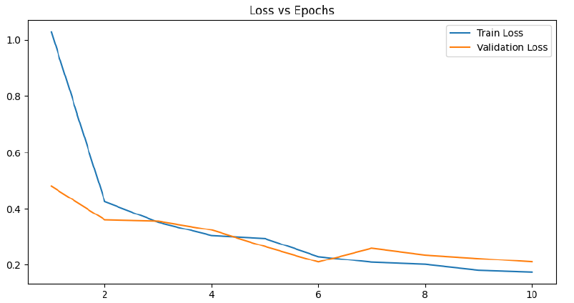
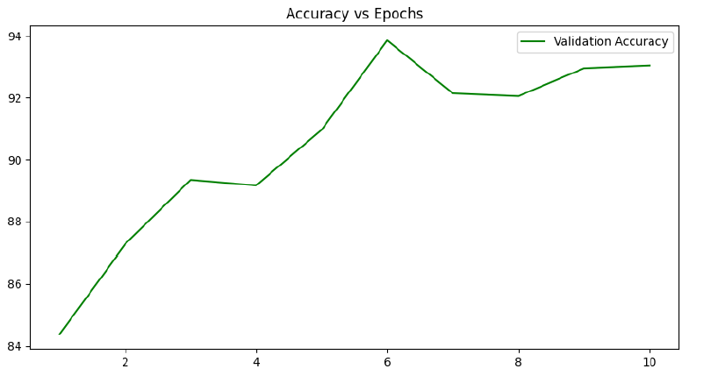
Training Process
Training and Validation Loss Curves:
Loss decreased steadily over 10 epochs.
Validation Accuracy:
Achieved a peak accuracy of 93.86% after 6 epochs.

Slide 9
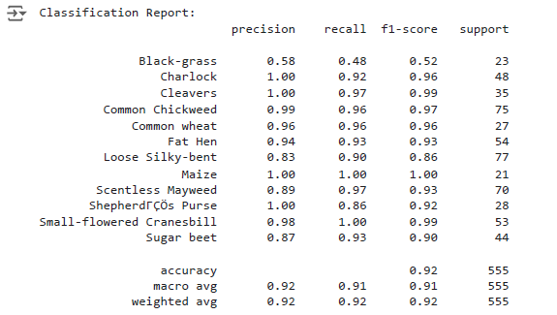
Evaluation Metrics
Classification Report:
Overall accuracy on the test set: 92%
Precision, recall, and F1-score metrics calculated for each class.
Confusion Matrix:
Visual representation of model performance on test data.
Misclassifications observed in visually similar classes.

Slide 10
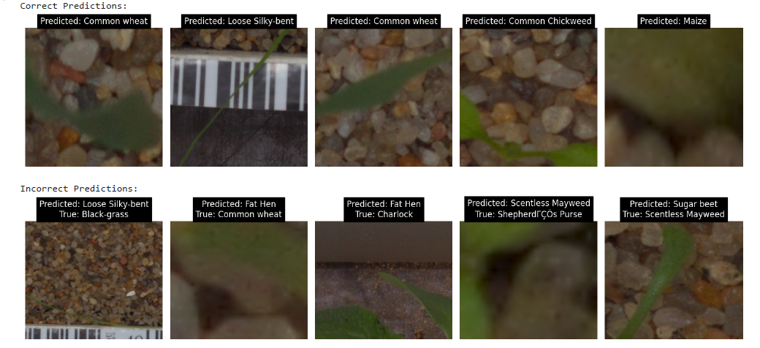
Correct and Incorrect Predictions
Correct Predictions: Examples where the model predicted the correct class.
Incorrect Predictions: Examples where the model misclassified the images.
Common misclassifications occurred between similar-looking species (e.g., Loose Silky-bent vs Black-grass).

Slide 11
Challenges Faced
Class Imbalance:
Some classes had significantly fewer samples (e.g., Black-grass).
Visual Similarity:
Certain classes (e.g., Loose Silky-bent and Black-grass) were difficult to distinguish, leading to confusion.
Limited Data:
The dataset size was relatively small for deep learning, which required data augmentation to improve performance.

Slide 12

Future Work
Expand Dataset: Collect more data to address class imbalance.
Try Advanced Architectures: Explore EfficientNet and DenseNet for potentially better performance.
Hyperparameter Tuning: Further optimize the learning rate, batch size, and other hyperparameters.
Implement Weighted Loss Function: To handle class imbalance more effectively.

Slide 13
Thank You

